Slide 1
TAMIZHAN SKILLS RISE INTERNSHIP – (DATABASE) Industry-Ready Enterprise Data Warehouse and Reporting Database
Presented by : kanika P
TS-RISE-DB-202606022

Slide 2
Project Overview
INTRODUCTION
Organizations generate large amounts of sales data daily. Analyzing this data helps businesses understand customer behavior, improve profitability, and make informed decisions.
This project develops a centralized data warehouse and interactive Power BI dashboard to analyze sales performance.

Slide 3
Problem Statement
Problem
Business data is often stored in multiple systems, making it difficult to generate meaningful insights.
Challenges:
Data scattered across different sources
Time-consuming reporting process
Difficulty tracking sales performance
Lack of real-time business insights

Slide 4
Project Objectives
Build a centralized data warehouse
Analyze sales, profit, and quantity data
Create interactive reports and dashboards
Monitor regional and category-wise performance
Support data-driven decision making

Slide 5
Technology Stack
Technology | Purpose
Python | Data Processing
Pandas | Data Cleaning & Transformation
SQL | Data Storage & Analysis
Power BI | Dashboard Creation
Data Warehouse | Centralized Data Repository

Slide 6
System Architecture
Data source (CSV dataset)
Python & Pandas
SQL Database
Data Warehouse
Business Insights
Data Cleaning and Transform
Power BI Dashboard

Slide 7

Data Warehouse Process
Extract
Collect sales data from source files.
Transform
Remove duplicates
Handle missing values
Standardize data
Load
Store processed data into SQL Data Warehouse.

Slide 8
Dataset Description
Dataset Attributes
Order ID
Order Date
Customer Name
Segment
Category
Product Name
Region
State
Sales
Profit
Quantity

Slide 9
KPI Analysis
Total Sales
2 Million
Total Profit
286 Thousand
Total Quantity Sold
38 Thousand
Total Orders
5009 Thousand
These KPIs provide a quick overview of business performance.

Slide 10
Segment Analysis
Sales by Segment
Consumer Segment
Highest contribution to sales
Corporate Segment
Second largest contributor
Home Office Segment
Lowest contribution

Slide 11
Category & Regional Analysis
Sales by Category
Technology has highest sales.
Furniture follows Technology.
Office Supplies contributes steadily.
Profit by Region
West Region generates highest profit.
East Region ranks second.
South and Central contribute moderate profit.

Slide 12

Sales Analysis
Sales by Year
Sales increased significantly after 2015.
Highest sales recorded in 2017.
Positive growth trend indicates business expansion.

Slide 13
Business Insights
Key Findings
Consumer Segment drives revenue.
Technology Category generates maximum sales.
West Region contributes highest profit.
Sales show consistent yearly growth.
Data warehouse enables faster reporting and analysis.

Slide 14
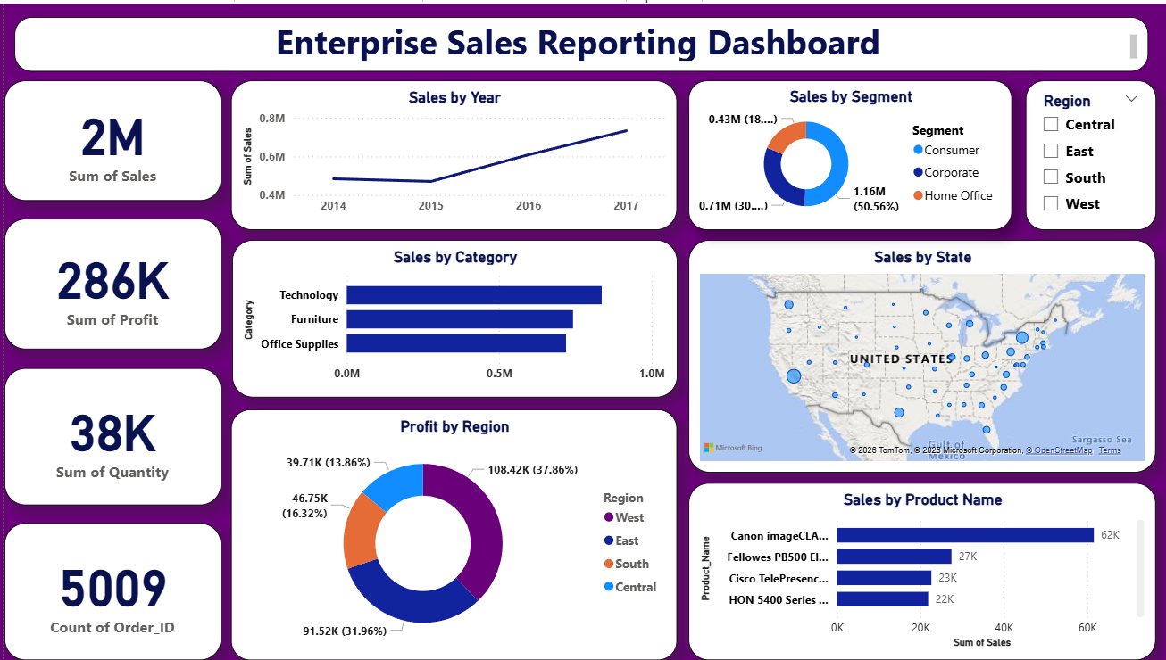
Dashboard

Slide 15
Conclusion The Enterprise Sales Reporting Dashboard successfully integrates Data Warehousing and Business Intelligence techniques to provide meaningful business insights. Future Enhancements Real-time data integration Sales forecasting using Machine Learning Automated report generation Cloud-based Data Warehouse AI-powered analytics

Slide 16
Thank You

